Slide 1
3D POSE based Computer Vision in Robotics
Zhenhao Zhang
2024.7.7-now

Slide 2
3D Pose on Hands
[CVPR'24]Reconstructing Hands in 3D with Transformers(HAMER)（√）
[NeurIPS'22]ViTPose: Simple Vision Transformer Baselines for Human Pose Estimation（√）
[IEEE Trans. PAMI'23]ViTPose++: Vision Transformer for Generic Body Pose Estimation（√）
[SIGGRAPH ASIA'17]Embodied hands-Modeling and capturing hands and bodies together(MANO)（√）
[ICCV'21]CPF: Learning a Contact Potential Field to Model the Hand-Object Interaction(A-MANO)（√）
[ICRA'23] DexGraspNet: A Large-Scale Robotic Dexterous Grasp Dataset for General Objects Based on Simulation（√）
[CVPR'24]MS-MANO: Enabling Hand Pose Tracking with Biomechanical Constraints
[CVPR'24]HOIDiffusion: Generating Realistic 3D Hand-Object Interaction Data
[CVPR'24]InterHandGen: Two-Hand Interaction Generation via Cascaded Reverse Diffusion
[CVPR'24]HandDiff: 3D Hand Pose Estimation with Diffusion on Image-Point Cloud
[CVPR'24]HHMR: Holistic Hand Mesh Recovery by Enhancing the Multimodal Controllability of Graph Diffusion Models
[CVPR'23]Affordance Diffusion: Synthesizing Hand-Object Interactions
[ICCV'23]Diffusion-Guided Reconstruction of Everyday Hand-Object Interaction Clips

Slide 3
Humanoid Motion
[CVPR'24]WHAM: Reconstructing World-grounded Humans with Accurate 3D Motion（√）
[CVPR'18]End-to-end Recovery of Human Shape and Pose(HMR2.0)
[ICCV'23]Humans in 4D: Reconstructing and tracking humans with transformers(SOTA based HMR2.0)
[ECCV'16]Keep it SMPL: Automatic Estimation of 3D Human Pose and Shape from a Single Image

Slide 4
Benchmark on Robotics
[ARXIV'24]Expressive Whole-Body Control for Humanoid Robots(ExBody)（√）
[ARXIV'24]HumanPlus: Humanoid Shadowing and Imitation from Humans

Slide 5
Diffusion
[NeurIPS'20]Denoising Diffusion Probabilistic Models(DDPM)
[ICLR'21]Denoising Diffusion Implicit Models(DDIM)

Slide 6
Paper List
https://github.com/xinghaochen/awesome-hand-pose-estimation（paper list for Hands）
https://zhuanlan.zhihu.com/p/406470702（paper list for Hand-Object）
https://0809zheng.github.io/2022/06/03/improved_ddpm.html（paper list for Diffusion）

Slide 7
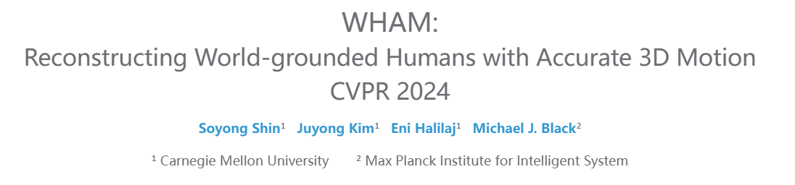

Slide 8
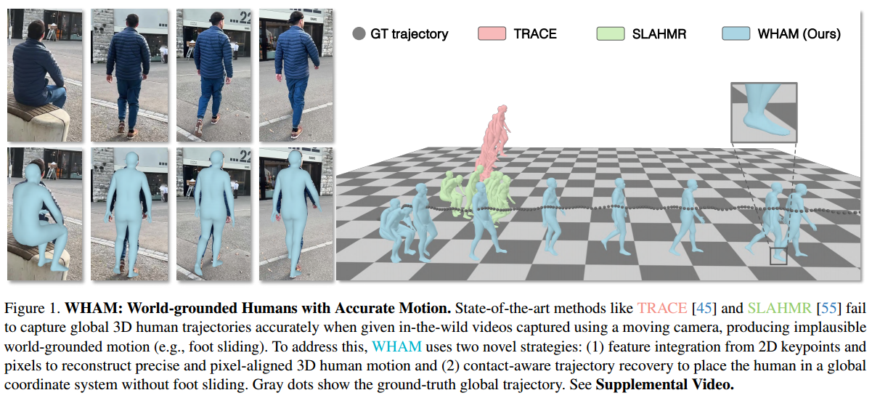
Challenge
Contribution
1.Camera based motion
2.Flat ground and food sliding
3.Computationally expensive optimization pipelines
4.Performence bad in video understanding
1.A New Method
2.A new benchmark without food sliding
3.World coordinate
4.performence state of the art

Slide 9
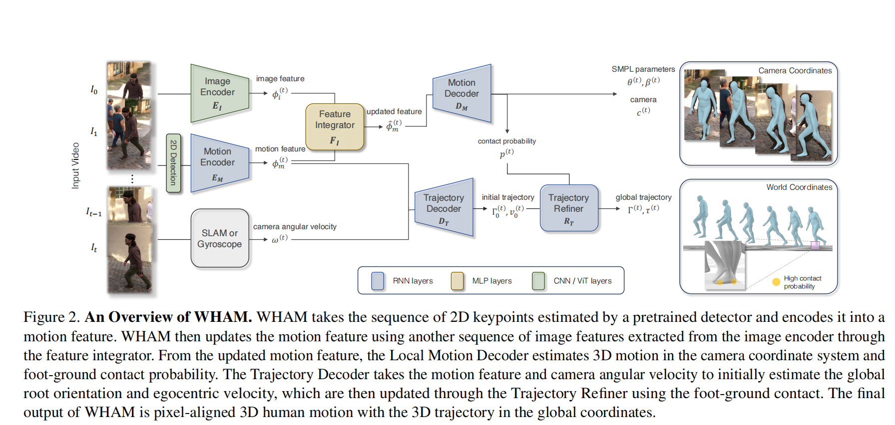

Slide 10
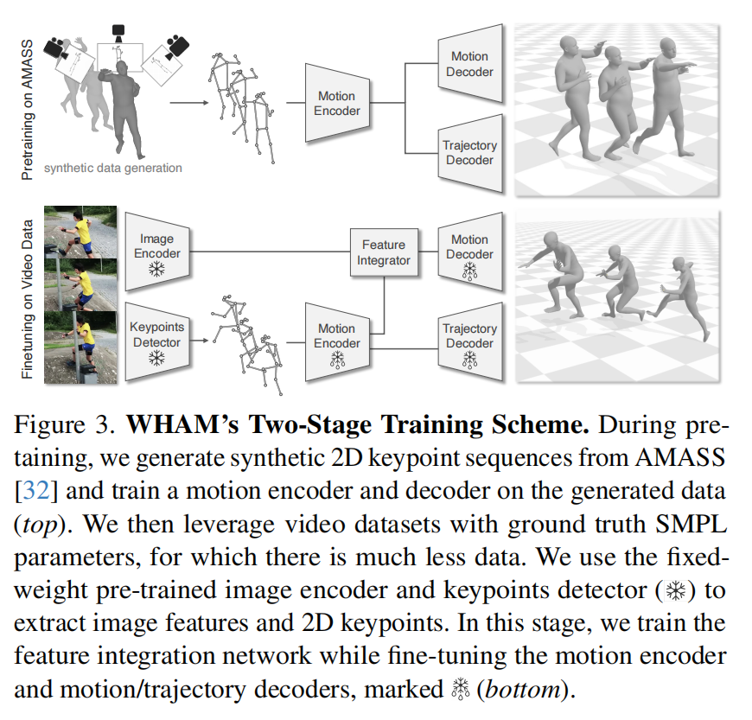

Slide 11
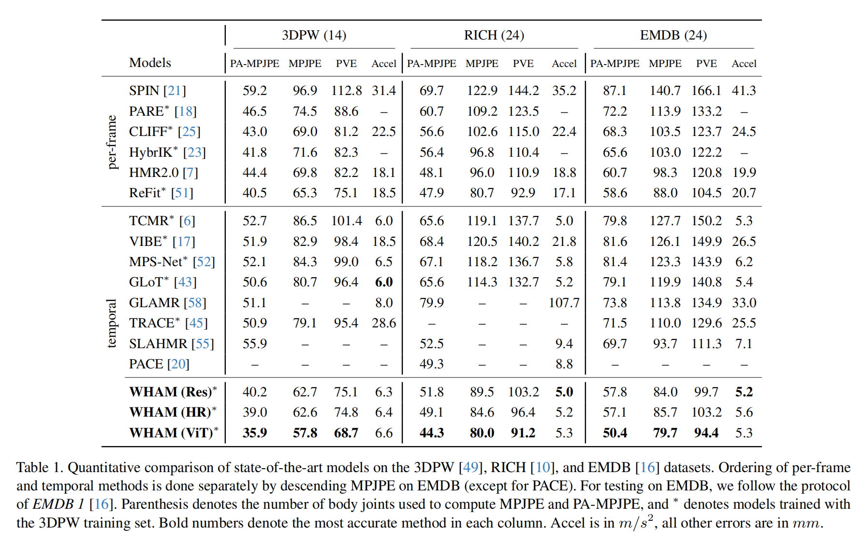

Slide 12
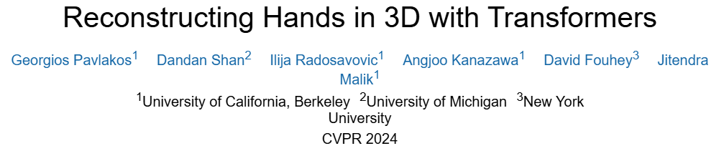

Slide 13
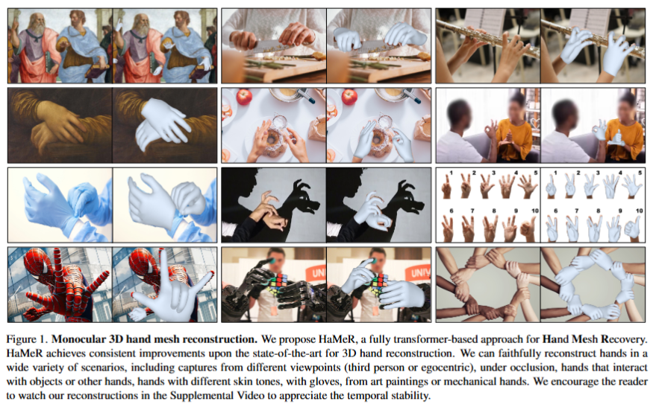

Slide 14
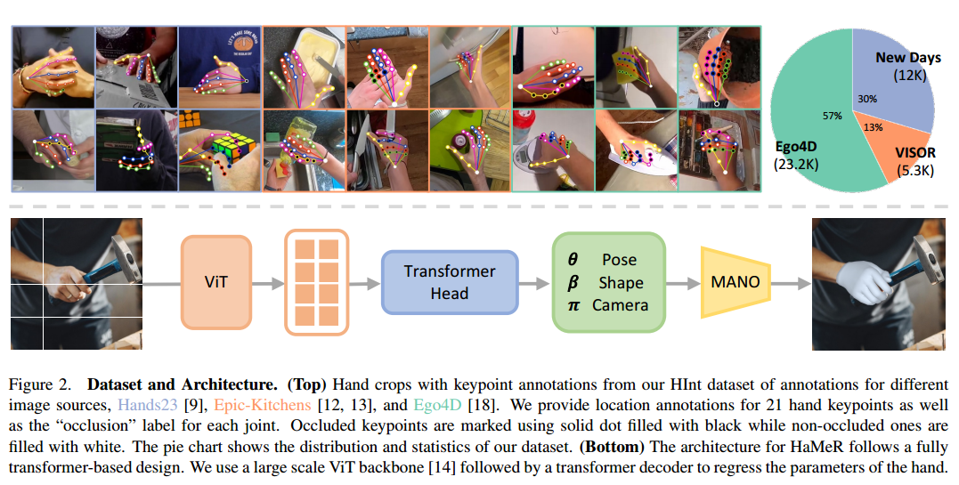

Slide 15
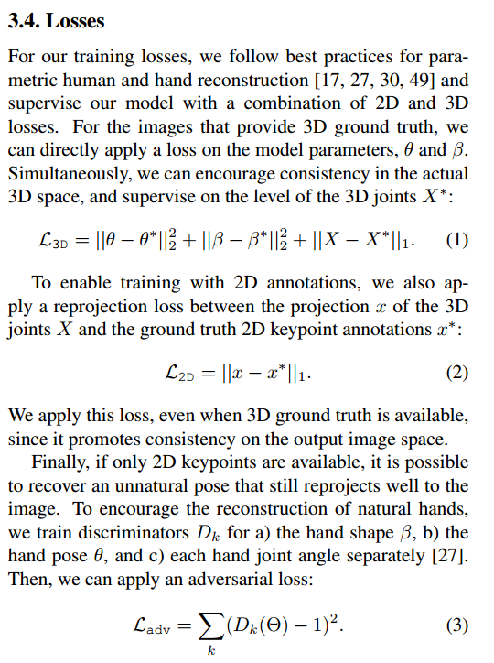
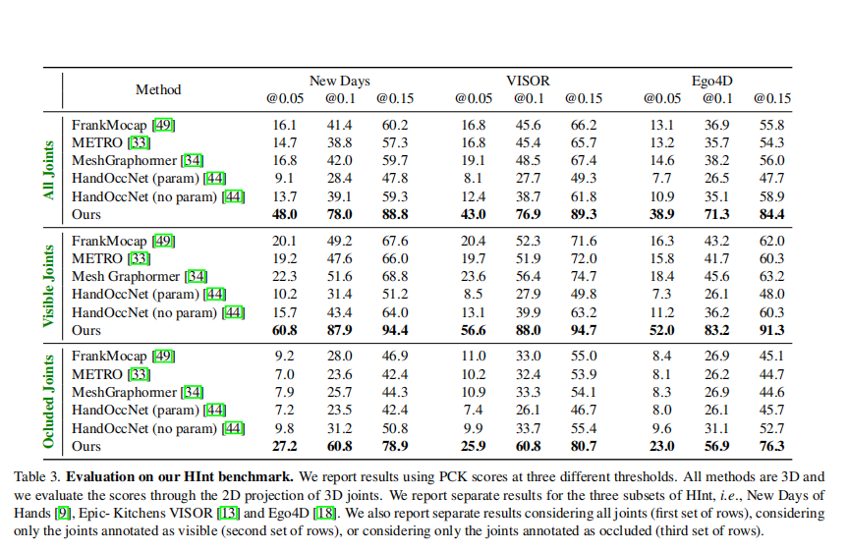

Slide 16
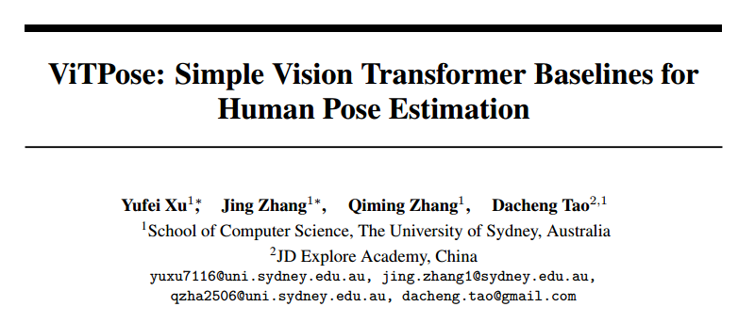
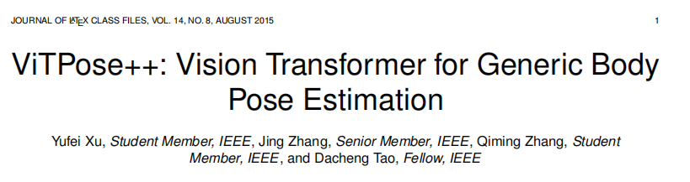
[NeurIPS'22]ViTPose: Simple Vision Transformer Baselines for Human Pose Estimation
[IEEE Trans. PAMI'23]ViTPose++: Vision Transformer for Generic Body Pose Estimation

Slide 17
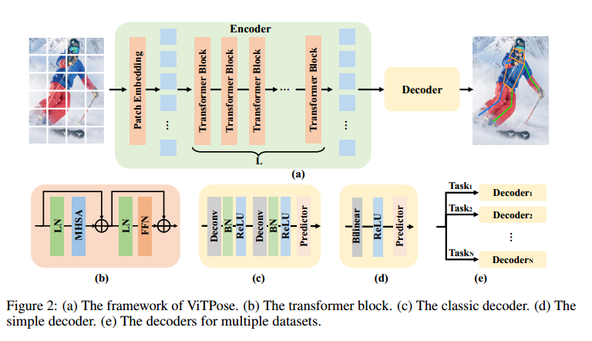

Slide 18
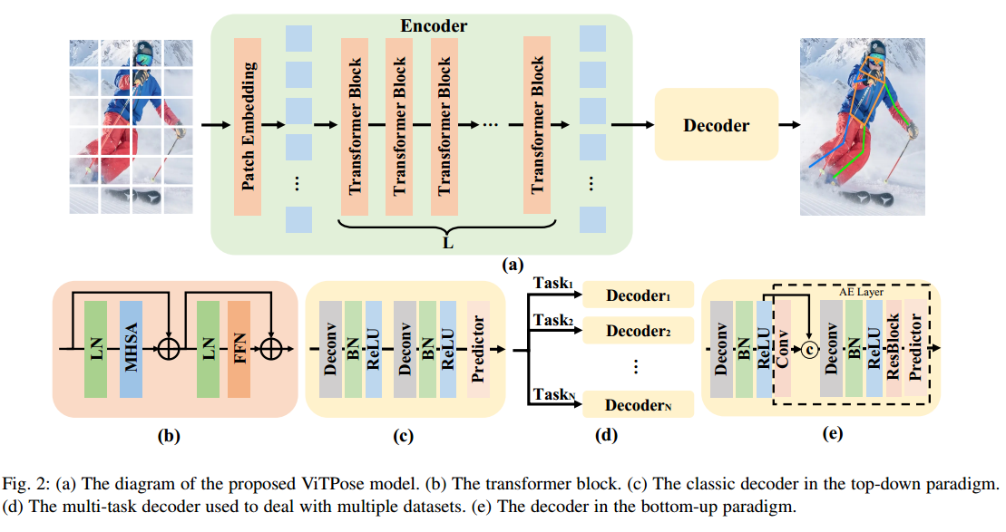

Slide 19
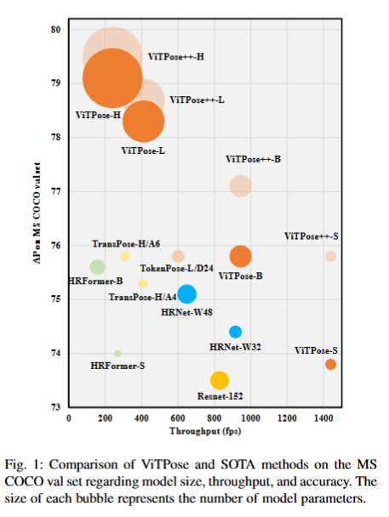
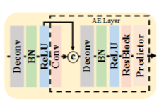

Slide 20
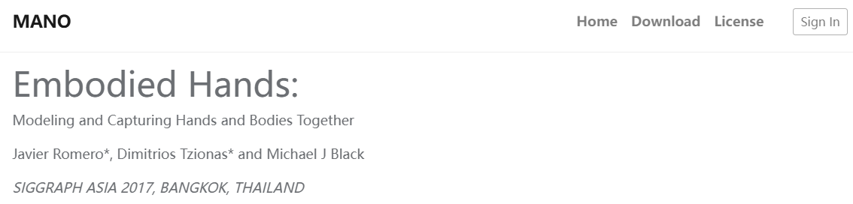

Slide 21
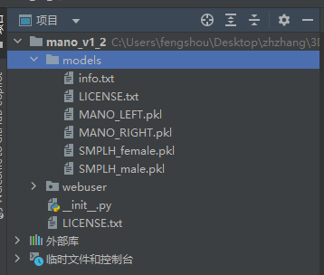
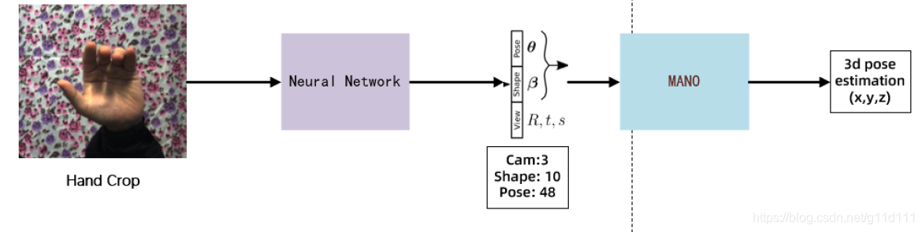
https://mano.is.tue.mpg.de/index.html
https://blog.csdn.net/g11d111/article/details/115539407
https://github.com/lixiny/manotorch
SMPL+MANO=SMPL+H

Slide 22
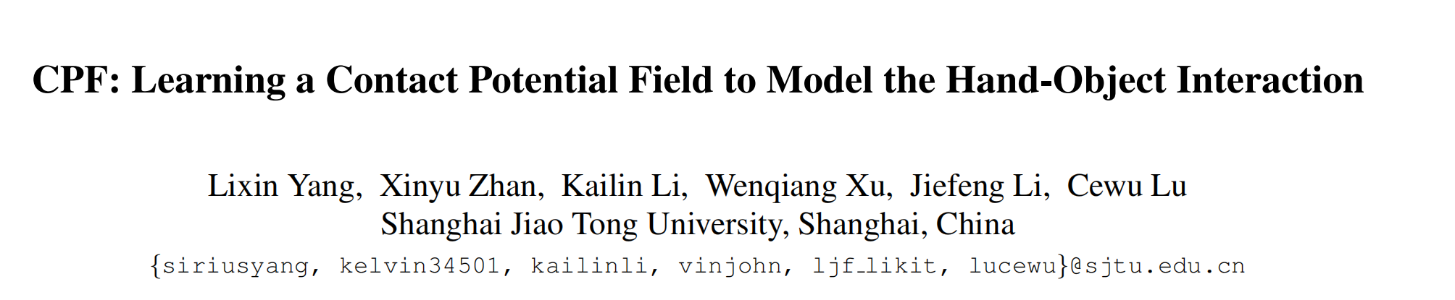
[ICCV'21]CPF: Learning a Contact Potential Field to Model the Hand-Object Interaction(A-MANO)

Slide 23
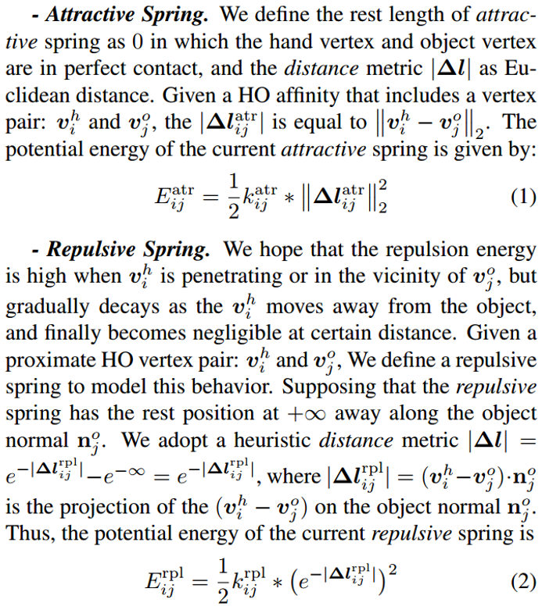
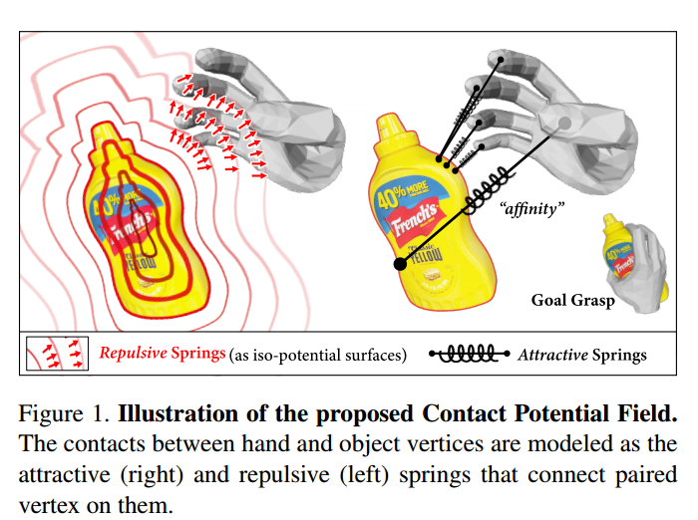
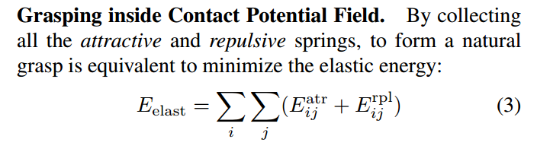
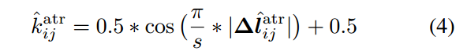

Slide 24
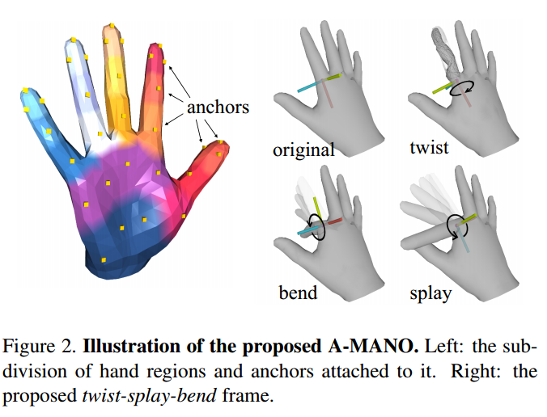

Slide 25
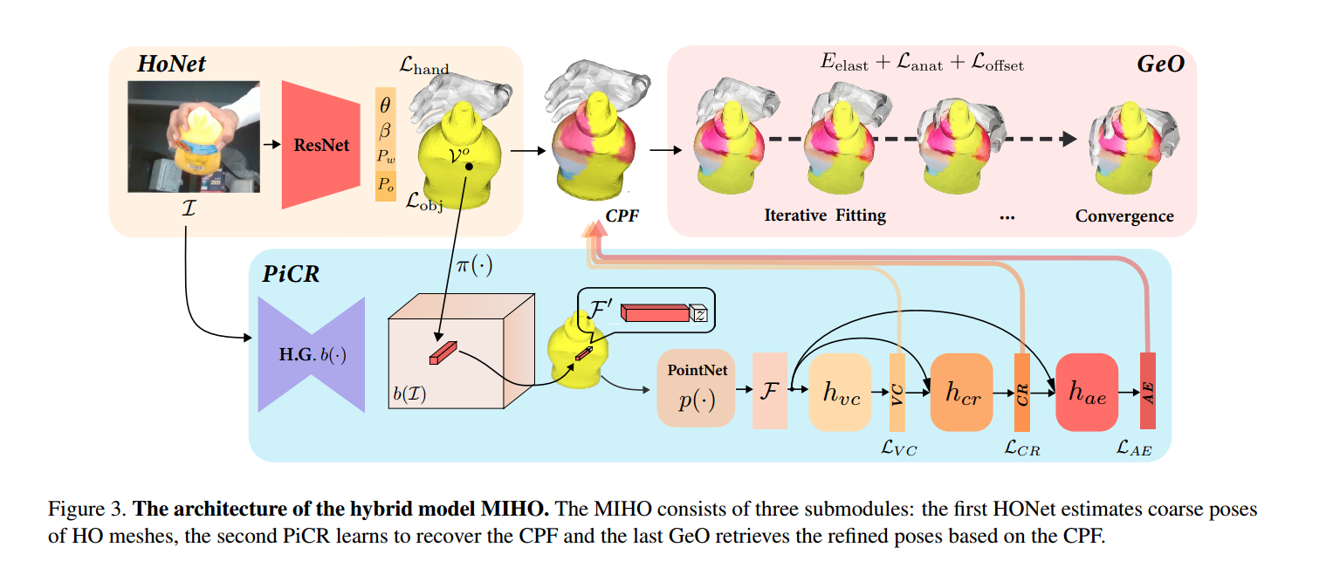

Slide 26
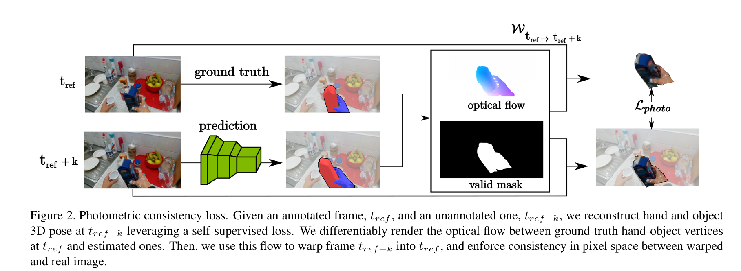
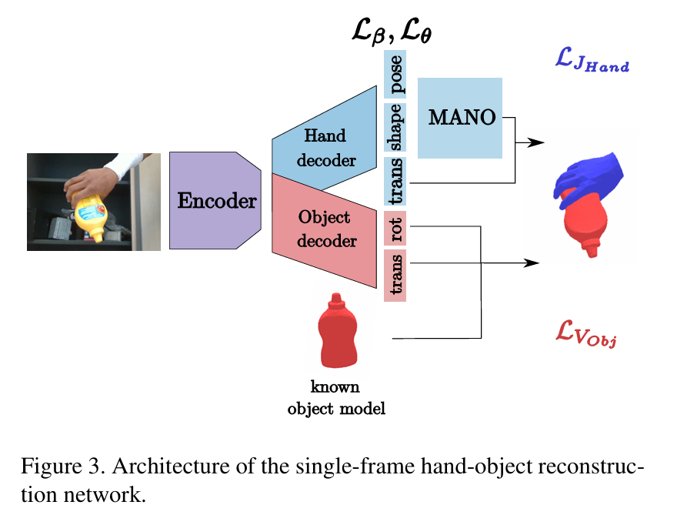
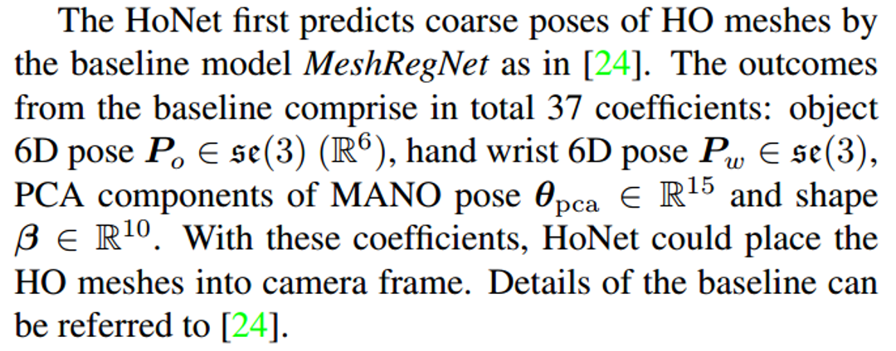
Hand-object Pose Estimation Network, HoNet

Slide 27
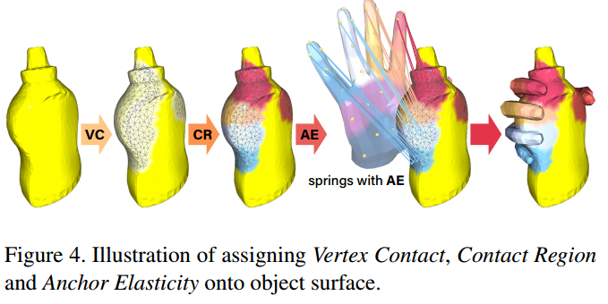
Pixel-wise Contact Recovery Module, PiCR

Slide 28
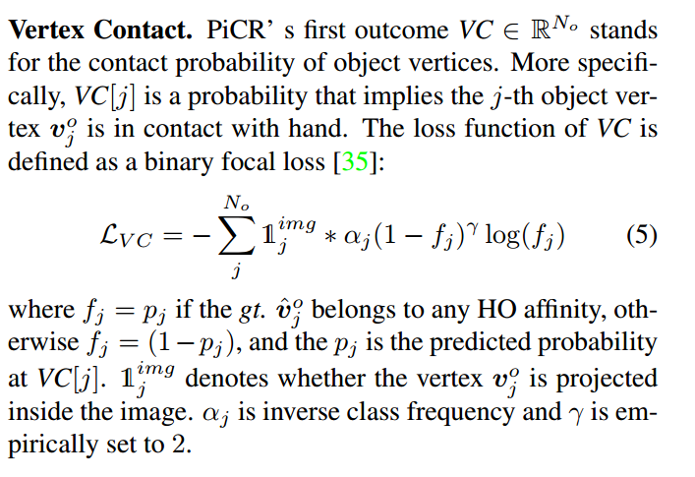

Slide 29
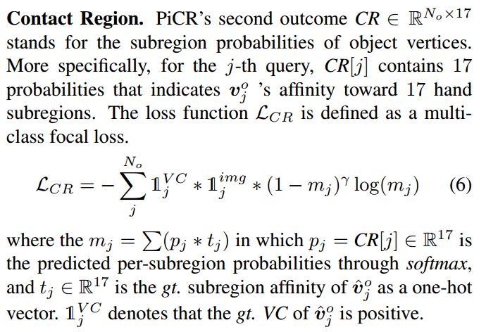

Slide 30
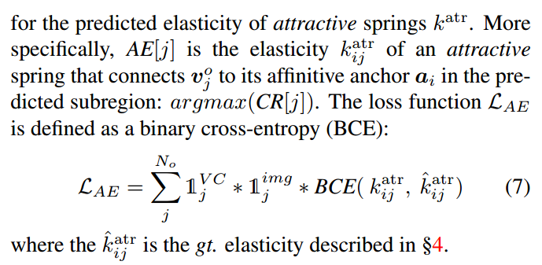

Slide 31
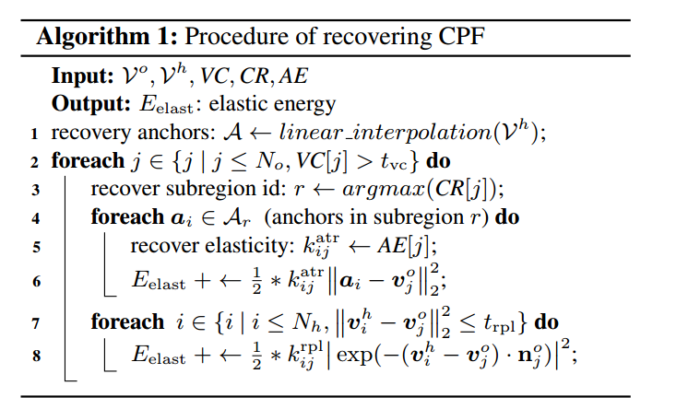

Slide 32
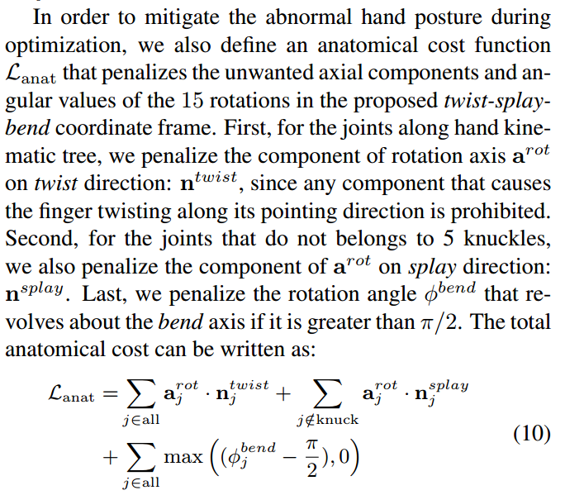
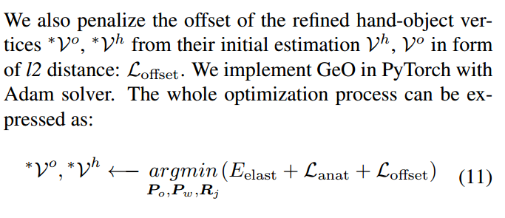
Grasping Energy Optimizer, GeO

Slide 33
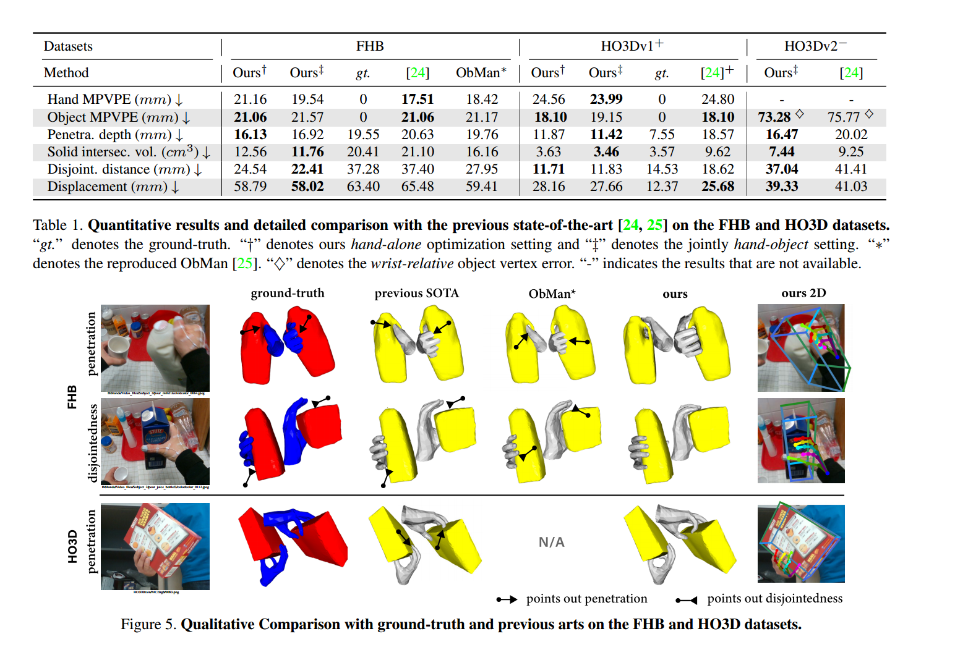

Slide 34
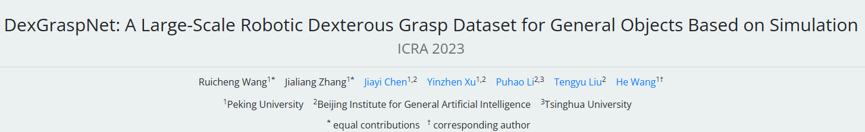

Slide 35
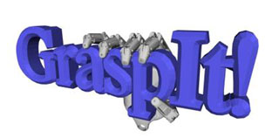
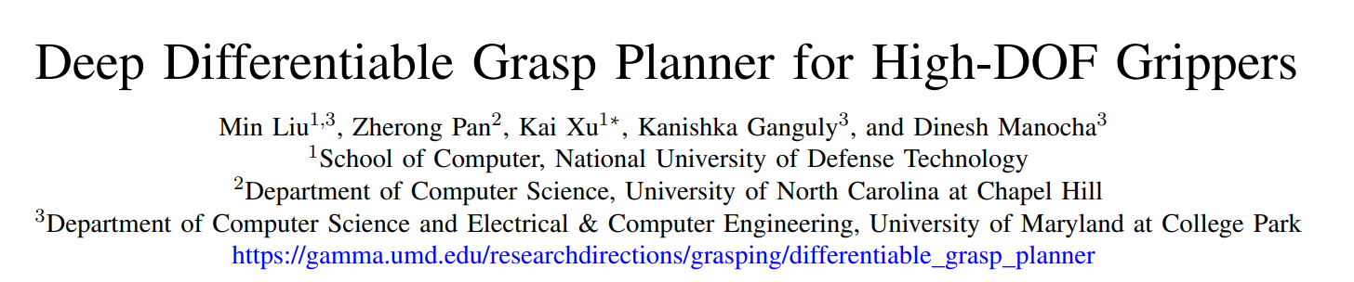
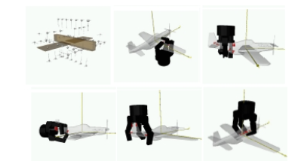
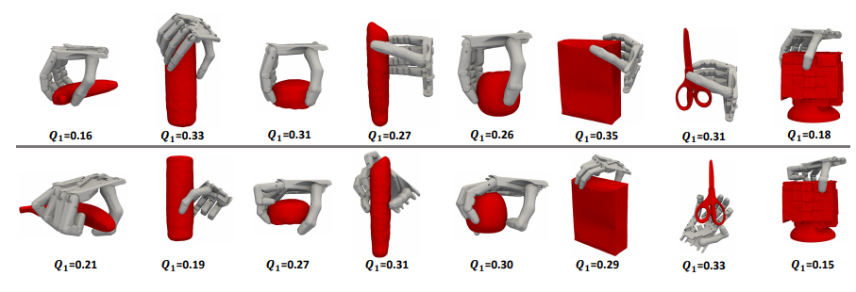
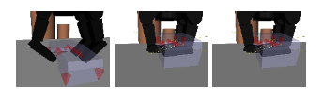

Slide 36
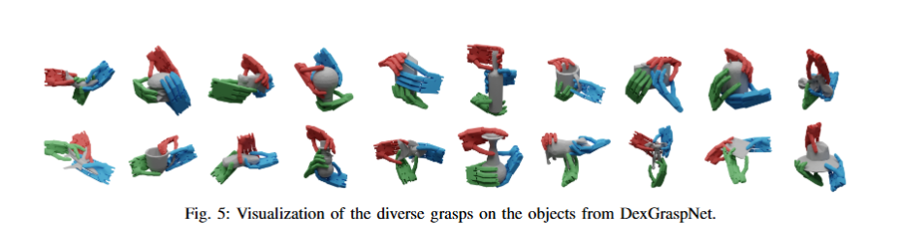
Website
https://wiki.ros.org/Robots/Shadow_Hand

Slide 37
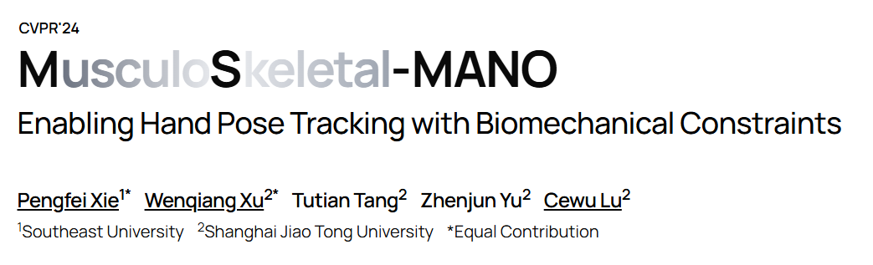

Slide 38
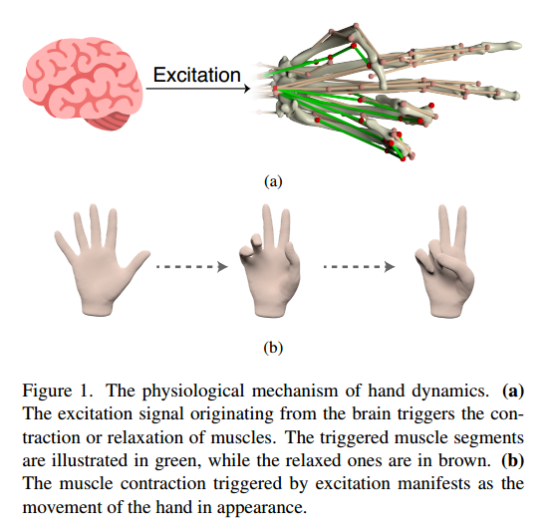

Slide 40
Website
https://robotflow.ai/
https://ms-mano.robotflow.ai/

